Slide 1

SCHOOL OF INFORMATION TECHNOLOGY AND ENGINEERING
FALL semester –2022-23
M.Tech (SE)
SWE3004 - Software Design and Development Project
Final Review
OBJECT DETECTION FOR VISUALLY IMPAIRED PEOPLE USING DEEP LEARNING ALGORITHM
Guide Name- Dr. KAMALAKANNAN J
Register Number - 18MIS0103
Student Name - P.S.KRISHNAPRASANTH

Slide 2
Abstract:
Blind people are unaware of the dangers they face. They can face many challenges while carrying out their daily activities in familiar surroundings. Vision is a necessary human sense and plays an important role in human perception of the environment. As such, there are a variety of computer vision products and services used to develop new electronic aids for the visually impaired. This project developed to give these people navigation. Guide people about objects. There is also an audio jack here to let you know about the object. Here we use the SSD algorithm for object detection.

Slide 3
OBJECTIVES OF THE PROJECT:
Since there has been a lot of research and experiments in Computer Vision and particularly its domain Object Detection and Recognition, there exists many different algorithms and models that strive to get nearly accurate results. There are following models available:
Single Shot Multibox Detector (SSD)
RCNN
You Only Look Once (YOLO)

Slide 4
Out of which we decided to work on SSD due to its benefits and high processing on real time data. Firstly, we gathered the COCO 2014 data for various objects including 80 classes. At first, we decided to use trained YOLO model. We considered the YOLO implementation to get a detailed insight of how object detection gets carried out in various models. We also tried SSD implementation of which we achieved better accuracy and performance than YOLO. Hence SSD was chosen as the primary model of project. Next we were successful in developing a basic prototype in python language and which could detect and recognize objects using a webcam, and provide voice output as well. Further this module was integrated in Android studio, and apk was generated.

Slide 5
SCOPE OF THE PROJECT:
No human intervention needed (automation)
Continuous Improvement
Handling multi-dimensional and multi-variety data x Wide Applications.

Slide 6
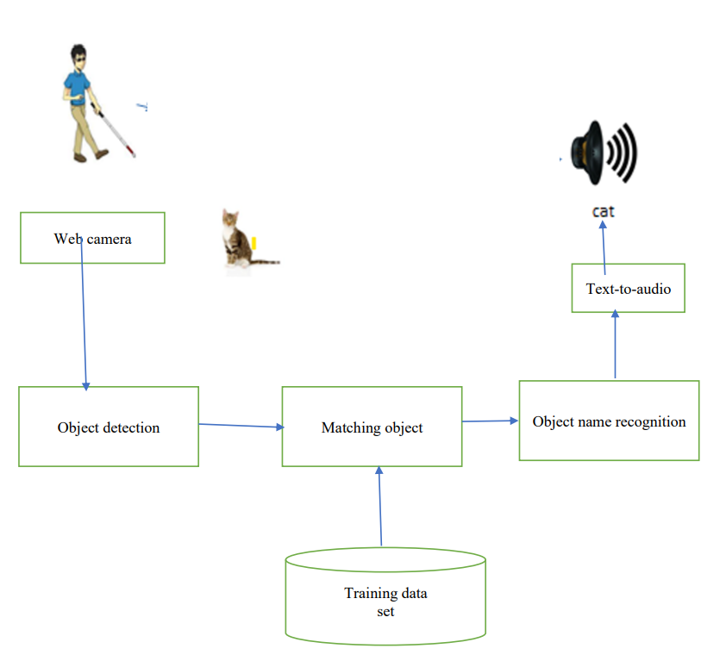
Architecture Diagram:

Slide 7
LITERATURE SURVEY:
1.TITLE: Design and Implementation of Guidance System for Visually Impaired People
YEAR OF PUBLISHING: 2021
AUTHOR NAME: Safwan Sadeq Alshahri;
ABSTRACT: As per the World Health Organization (WHO) statistics, there are there are 285 million visually disabled people worldwide, of whom 39 million are completely blind. To help those blind people and improve their lives quality, several systems have been developed including the guidance systems. The guidance systems are essential to assist and monitor the location of visually impaired people. Therefore, this paper aims to design and develop a guidance system with self-administered approach to help the blind people practicing their normal life. In the proposed system, a wearable vest is used to help the bind people avoid obstacles or any risk during walking. The ultrasonic sensors are attached to the vest, which blind people wear to detect the object. In addition to detecting the objects, the proposed system uses GPS system and GSM module to monitor the location of the visually disabled people. The system alerts the user if there is an obstacle by vibrating, and if the user gets closer the second alert will be a voice warning to tell the visually impaired user where the obstacle is (e.g., left, or right side). The experimental results show that the proposed system can detect objects accurately that are 120 cm away and trigger a real time alert to allow the blind person to respond quickly

Slide 8
2.TITLE: Design of Smart Cane with integrated camera module for visually impaired people
YEAR OF PUBLISHING:2021
AUTHOR NAME: T Lavanya Narayani.; M Sivapalanirajan.;
ABSTRACT: In the world, millions of visually impaired or blind people are living. They are always dependent on other people or trained pets to move through an unknown environment. A typical walking stick cannot meet the safety monitoring and guidance requirement of blind people. This paper focuses on designing and developing a smart cane capable of sensing and signaling the environmental features around visually impaired people. The proposed smart cane has two ultrasonic sensors for measuring the distance between the smart cane to the stationary and hanging objects found to be an obstacle. Alert signal is provided by the actuator when the obstacle is falling inside a threshold level of 2 meters. The design integrates a camera module ESP-32 to capture the moving object/people's image in addition to the obstacle detection. The camera module gets enable signal from the PIR sensor to capture the image of the moving object/person and save processor time. It also provides information about the situation around the blind person and their relatives in case of an emergency. It provides the implementation cost and power requirement of the smart cane to develop a camera-enabled stick.

Slide 9
3.TITLE: Guidance System for Visually Impaired People
YEAR OF PUBLISHING:2021
AUTHOR NAME: Kanchan Patil; Avinash Kharat;
ABSTRACT: There are some visually impaired people throughout the world. Some of them may be around
us. The visually impaired person finds difficulty while performing day-to-day life tasks. So this research work aims to develop a device which helps them as personal assistant. This paper represents the proposed device's integrated modules and functionalities that can help a blind person. The proposed idea is to provide a wearable device with a Virtual assistant system for the visually impaired person, for some of the basic tasks without requiring the help of others. The system is aimed to provide voice-over assistants for blind people to do tasks like understanding surroundings, looking for an object, recognizing the face of a person with
emotion, and reading etc. There is a total of five components merged into one system in this
project. The navigation through these components is possible through hardware buttons and
voice-over commands given by the user. There are many deep learning methodologies and core libraries of python language used for programming. The complete project is dedicated to being simple to use by visually impaired people and making day to day tasks easy for them.

Slide 10
4.TITLE: Faster R-CNN: Towards Real-Time Object Detection with Region Proposal Network
YEAR OF PUBLISHING:2021
AUTHOR NAME :Shaoqing Ren, Kaiming He, Ross Girshick, and Jian Sun
ABSTRACT:
State-of-the-art object detection networks depend on region proposal algorithms to hypothesize
object locations. Advances like SPPnet and Fast R-CNN have reduced the running time of these detection networks, exposing region proposal computation as a bottleneck. In this work, we introduce a Region Proposal Network (RPN) that shares full-image convolutional features with the detection network, thus enabling nearly cost-free region proposals. An RPN is a fully
convolutional network that simultaneously predicts object bounds and objectness scores at each position. The RPN is trained end-to-end to generate high-quality region proposals, which are used by Fast R-CNN for detection. We further merge RPN and Fast R-CNN into a single network by sharing their convolutional features---using the recently popular
terminology of neural networks with 'attention' mechanisms, the RPN component tells the unified network where to look.

Slide 11
5.TITLE: You Only Look once : Unified, Real-Time Object Detection
YEAR OF PUBLISHING: 2020
AUTHOR NAME: J Redmon, S Divvala, R Girshick
ABSTRACT:
We present YOLO, a new approach to object detection. Prior work on object detection
repurposes classifiers to perform detection. Instead, we frame object detection as a regression
problem to spatially separated bounding boxes and associated class probabilities. A single
neural network predicts bounding boxes and class probabilities directly from full images in one evaluation. Since the whole detection pipeline is a single network, it can be optimized end-to-end directly on detection performance. Our unified architecture is extremely fast. Our base YOLO model processes images in real-time at 45 frames per second. A smaller version of the network, Fast YOLO, processes an astounding 155 frames per second while still achieving double the mAP of other real-time detectors. Compared to state-of-the-art detection systems, YOLO makes more localization errors but is far less likely to predict false detections where nothing exists. Finally, YOLO learns very general representations of objects. It outperforms all other detection methods, including DPM and R-CNN, by a wide margin when generalizing from natural images to artwork on both the Picasso Dataset and the People-Art Dataset.

Slide 12
6.TITLE:Blind Person Assistant: Object Detection
YEAR OF PUBLISHING: 2020
Authors: Aniket Birambole, Pooja Bhagat, Bhavesh Mhatre, Prof. Aarti Abhyankar
ABSTRACT:
It’s a known fact that estimated number of blind persons in the world is about 285 million, approximately equal to the 20% of the Indian Population. They are mostly dependent on someone for even accessing their basic daily needs. In our project, we used TensorFlow, it\'s a new library from Google. TensorFlow model our neural networks. The TensorFlow Object Detection API is used to detect many objects. We have Introduce an algorithm (SSD). SSD uses a similar phase while training, to match the appropriate anchor box with the bounding boxes of each ground truth object within an image. Essentially, the anchor box with the highest degree of flap with an object is responsible for predicting that object\'s class and its location. It has microcontroller which has wi-fi inbuilt module. This guide is convenient and offers data to the client to move around in new condition, regardless of whether indoor or open air, through an ease to use interface. Then again, and so as to lessen route challenges of the visually impaired, a deterrent location framework utilizing ultrasounds is added to this gadget. The proposed framework identifies the closest hindrance through ultrasonic sensors and it gives an alert to illuminate the visually impaired about its confinement.

Slide 13
REQUIREMENTS
HARDWARE REQUIREMENTS:
Processor - I5
Speed - 3 GHz
RAM - 8 GB(min)
Hard Disk - 500 GB
Key Board - Standard Windows Keyboard
Mouse - Two or Three Button Mouse
Monitor - SVGA

Slide 14
SOFTWARE REQUIREMENTS:
Operating System: Linux, Windows/7/10
Server: Anaconda, Jupyter,pycharm
Front End: tkinter |GUI toolkit
Server side Script: Python , AIML

Slide 15
MODULE DESCRIPTION:
LIST OF MODULES:
DATASETS : This requires an image dataset of the objects to train the classifier. In this project we have used COCO (Common Objects in Context) 2014 Database with 80 different object classes which have 83K training images, 41K Testing images. The dataset used is the labelled dataset which is useful to train the model. Some of the objects among 80 classes are as follows:
Person: person
Animal: cat, cow, dog, horse, sheep etc
Vehicle: bicycle, boat, bus, car, motorbike, train, truck etc
Indoor: bottle, chair, dining table, potted plant, sofa, bed, TV/monitor, laptop etc
Other: bench ,traffic light, fire hydrant, stop sign
DATA PREPARATION: The COCO dataset was downloaded from cocodataset.org

Slide 16
DATA LABELING : The images are labeled by using LabelImg software. For some images the annotations file is downloaded with the dataset itself. Annotation file contains parameters object_class, unique object_id, x_coordinate for center, incoordinate for center, width and height for each image.
TRAIN-TEST SPLIT: After collecting and annotating the dataset, we randomly shuffle the data to select 80% of the data on which we train the model. The remaining 20% of the data, unseen by the model, is used for the testing of the model.
MODEL TRAINING: The main idea behind making object detection or object classification model is Transfer Learning which means using an efficient pre-trained model. Here we have using three models : Object Detection API provided by TensorFlow (uses SSD mobilenet v1), MULTIBOX and YOLO. By default Object Detection API by Tensor is used since it was found to be most efficient.

Slide 17
REAL TIME VIDEO PROCESSING: The frames are captured at the rate of - frames per second with preview size of 640 x 680. The stable output is generated for the real-time input.
OBJECT DETECTION: Object detection Bounding boxes are generated which predicts the certainty called as confidence score. This score lets us know that the bounding box consists of some object. For every bounding box, the cell predicts a class of that object which gives a distribution of probability among all the available classes in the given model. The confidence score along with the probability just calculated, gives us the final score which lets the user know how likely it is that the bounding box contains some specific object.

Slide 18
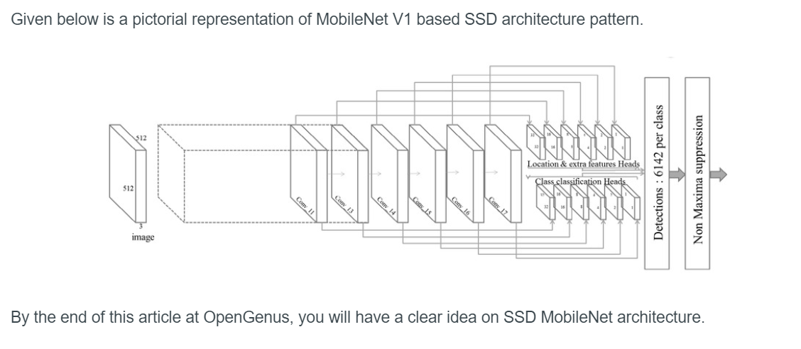
DESIGN:
SDD MOBLIE NET ARCHITECTURE:

Slide 19
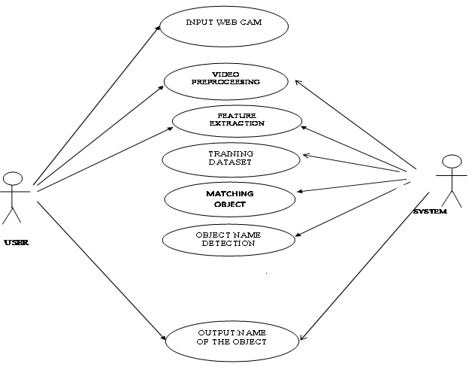
USE CASE DIAGRAM:

Slide 20
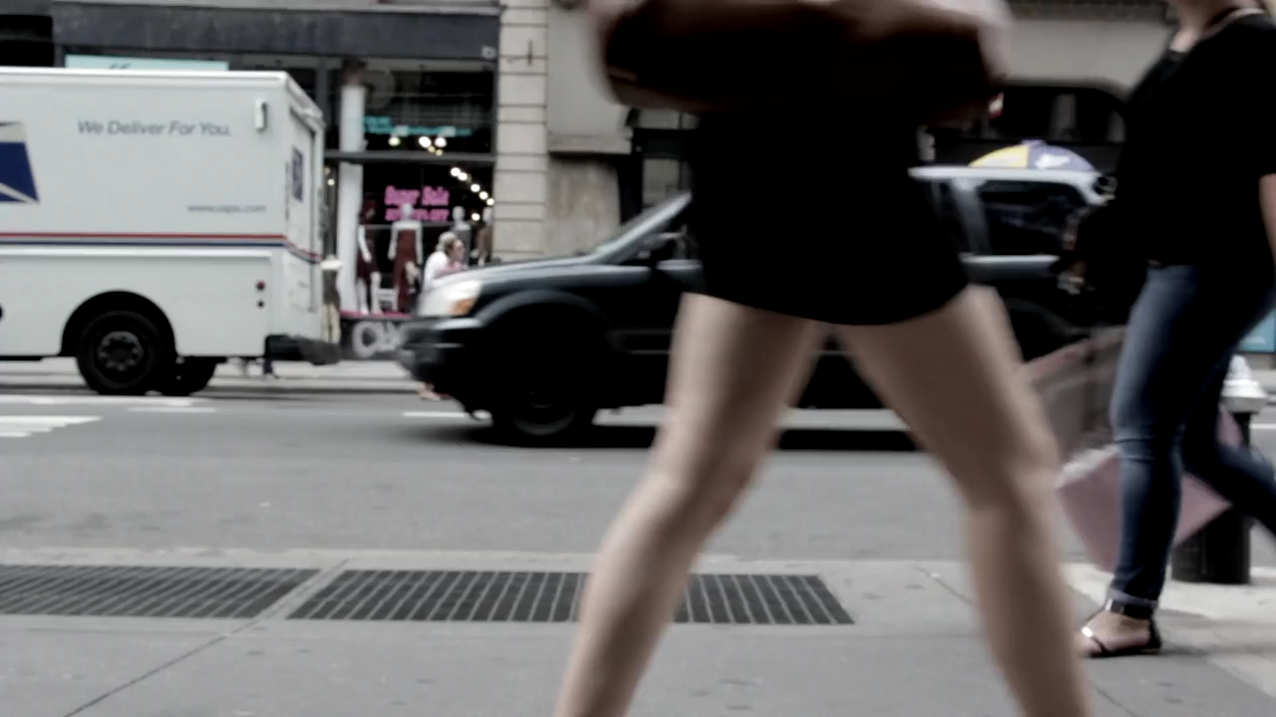
RESULTS:
Input:

Slide 21
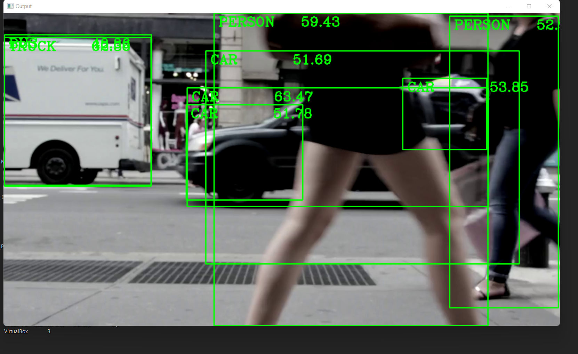
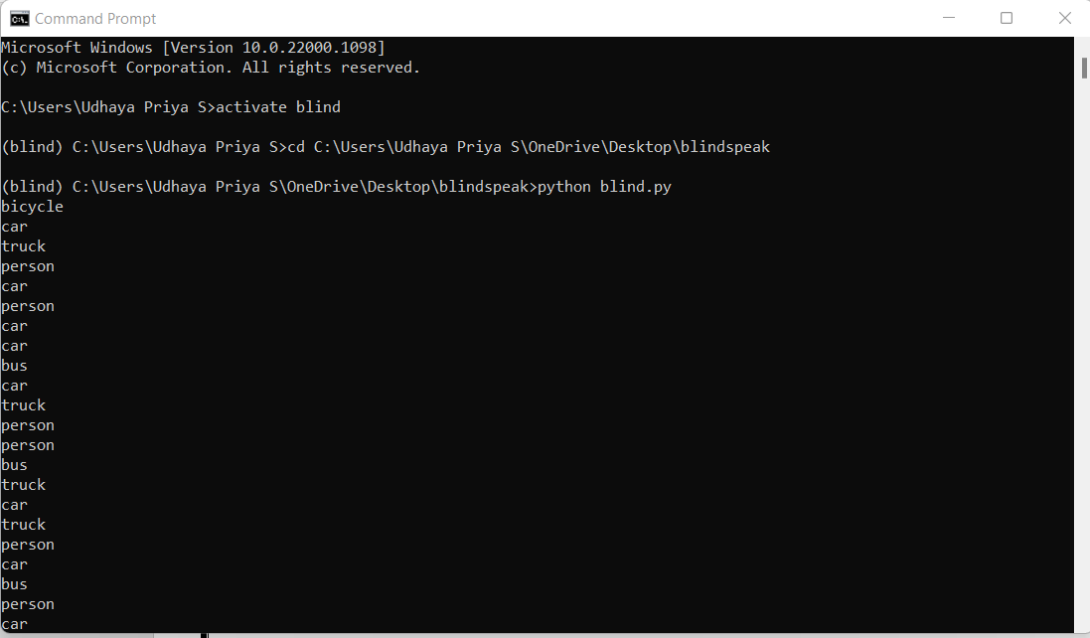
Output:

Slide 22
CONCLUSION AND FUTURE WORK:
In this project, an object detection system for visually impaired people based on SSD algorithm in real time has been proposed. The proposed system is beneficial for the visual impaired people for better living quality to detect the object as well as calculating the distance of the object.
For future work, there’s still so many possibility of improvement, like real time distance calculation.
In future we can develop a full application with user friendly. Then we can commercialize

Slide 23
REFERENCES:
[1] Bc. Jan Hadáček, “Application of a Camera in a Mobile Phone for Visually Impaired People.” Masters thesis, Czech Technical University in Prague, May 2017.J. Clerk Maxwell, A Treatise on Electricity and Magnetism, 3rd ed., vol. 2. Oxford: Clarendon, 1892, pp.68-73.
[2] “Faster R-CNN: Towards Real-Time Object Detection with Region Proposal Networks.” ShaoqingRen, Kaiming He, Ross Girshick, and Jian Sun, IEEE transactions, Dec 2016.
[3] “You Only Look once: Unified, Real -Time Object Detection.” J Redmon, S Divvala, R Girshick, A Farhadi, IEEE transactions, May 2016.R. Nicole, “Title of paper with only first word capitalized,” J . Name Stand. Abbrev., in press.
[4] “SSD: Single Shot MultiBox Detector Wei Liu.”, DragomirAnguelov, DumitruErhan, Christian Szegedy, Scott Reed, Cheng-Yang Fu, Alexander C. Berg, IEEE transactions, Jan 2016.
[5] Image recognition: By SamerHijazi, Rishi Kumar, and Chris Rowen, IP Group, Cadence“Using convolutional neural network for image recognition”.
[6] Vicky Mohane, ChetanGade “Object Recognition for Blind people Using Portable Camera” WCFTR World conference 2016.

Slide 24
[7] MeghajitMazumdar, Dr. Sarasvathi V, Akshay Kumar “Object Recognition in Videos by Sequential Frame Extraction using Convolutional Neural Networks and Fully Connected Neural Networks” International Conference on Energy, Communication, Data Analytics and Soft Computing 2017.
[8] Yide Ma, Dong Hwan Kim, and Sung-Kee Park “Region-Based Object Recognition by Color Segmentation Using a Simplified_PCNN” IEEE transactions on neural network and learning system, Vol, 26 No. 8 Aug 2015.
[9] Mingjie Liang, Huaqing Min, RonghuaLuo, and Jinhui Zhu, “Simultaneous Recognition and Modeling for Learning 3-D Object Models From Everyday Scenes” IEEE transcation on cybernetics, Vol 45 No. 10 Oct. 2015.
[10]Bc. Jan Hadáček, “Application of a Camera in a Mobile Phone for Visually Impaired People.” Masters thesis, Czech Technical University in Prague, May 2017.J. Clerk Maxwell, A Treatise on Electricity and Magnetism, 3rd ed., vol. 2. Oxford: Clarendon, 1892, pp.68-73.
[11]“Faster R-CNN: Towards Real-Time Object Detection with Region Proposal Networks.” Shaoqing Ren, Kaiming He, Ross Girshick, and Jian Sun, IEEE transactions, Dec 2016.
[12] “You Only Look once: Unified, Real-Time Object Detection.” J Redmon, S Divvala, R Girshick, A Farhadi, IEEE transactions, May 2016.R. Nicole, “Title of paper with only first word capitalized,” J. Name Stand. Abbrev., in press.

Slide 25
[13] “SSD: Single Shot MultiBox Detector Wei Liu.”, Dragomir Anguelov, Dumitru Erhan, Christian Szegedy, Scott Reed, Cheng-Yang Fu, Alexander C. Berg, IEEE transactions, Jan 2016.
[14] Image recognition: By Samer Hijazi, Rishi Kumar, and Chris Rowen, IP Group, Cadence “Using convolutional neural network for image recognition”.
[15] Vicky Mohane, Chetan Gade “Object Recognition for Blind people Using Portable Camera” WCFTR World conference 2016.
[16] Meghajit Mazumdar, Dr. Sarasvathi V, Akshay Kumar “Object Recognition in Videos by Sequential Frame Extraction using Convolutional Neural Networks and Fully Connected Neural Networks” International Conference on Energy, Communication, Data Analytics and Soft Computing 2017.
[17] Yide Ma, Dong Hwan Kim, and Sung-Kee Park “Region-Based Object Recognition by Color Segmentation Using a Simplified_PCNN” IEEE transactions on neural network and learning system, Vol, 26 No. 8 Aug 2015.
[18] Chen X, Yuille AL. A time-efficient cascade for real-time object detection: With applications for the visually impaired. In2005 IEEE Computer Society Conference on Computer Vision and Pattern Recognition (CVPR’05)-Workshops 2005 Sep 21:28-28.
[19] Chi-Sheng, Hsieh. “Electronic talking stick for the blind.” U.S. Patent No. 5,097,856, 24 Mar. 1992.
[20] Mingjie Liang, Huaqing Min, Ronghua Luo, and Jinhui Zhu, “Simultaneous Recognition and Modeling for Learning 3-D Object Models From Everyday Scenes” IEEE transcation on cybernetics, Vol 45 No. 10 Oct. 2015.

